Slide 1
AWS Cloud Support
AWS EC2 Instance Creation

Slide 2
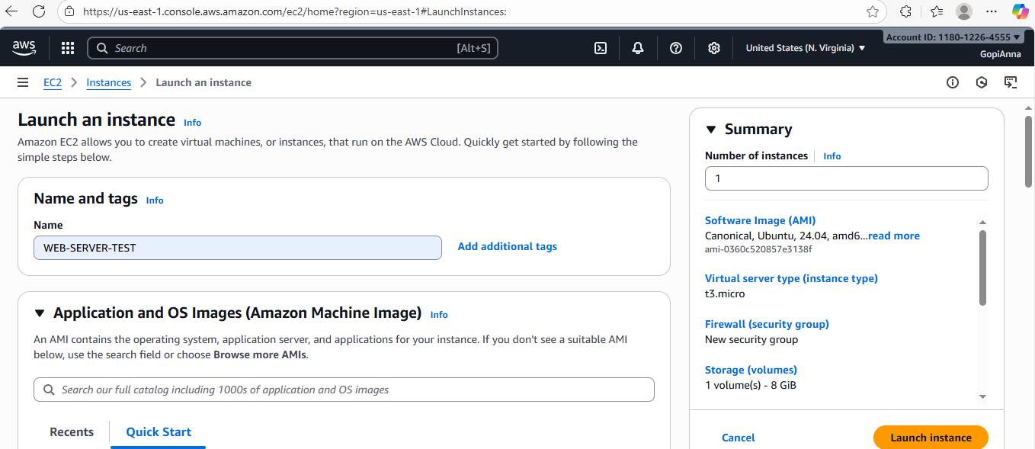
Login as IAM user
Navigate to EC2 Instance => Launch an Instance
Name and tags => WEB-SERVER-TEST

Slide 3
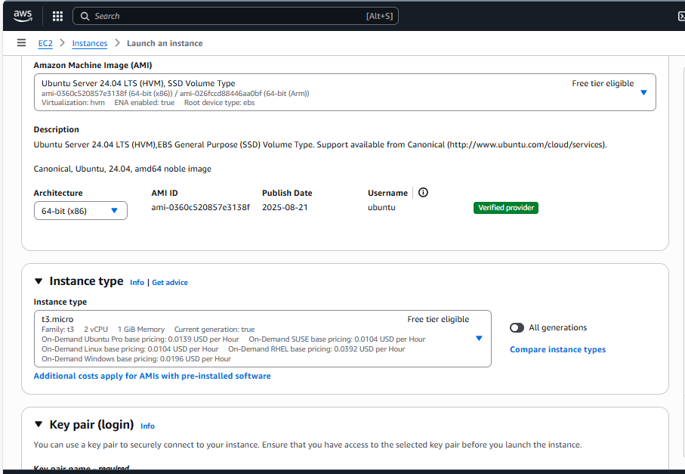
Select image => Application and OS Images (Amazon Machine Image) Ubuntu server

Slide 4
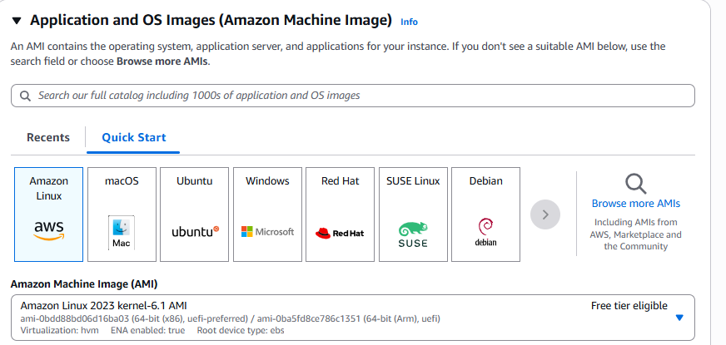
OS Images

Slide 5
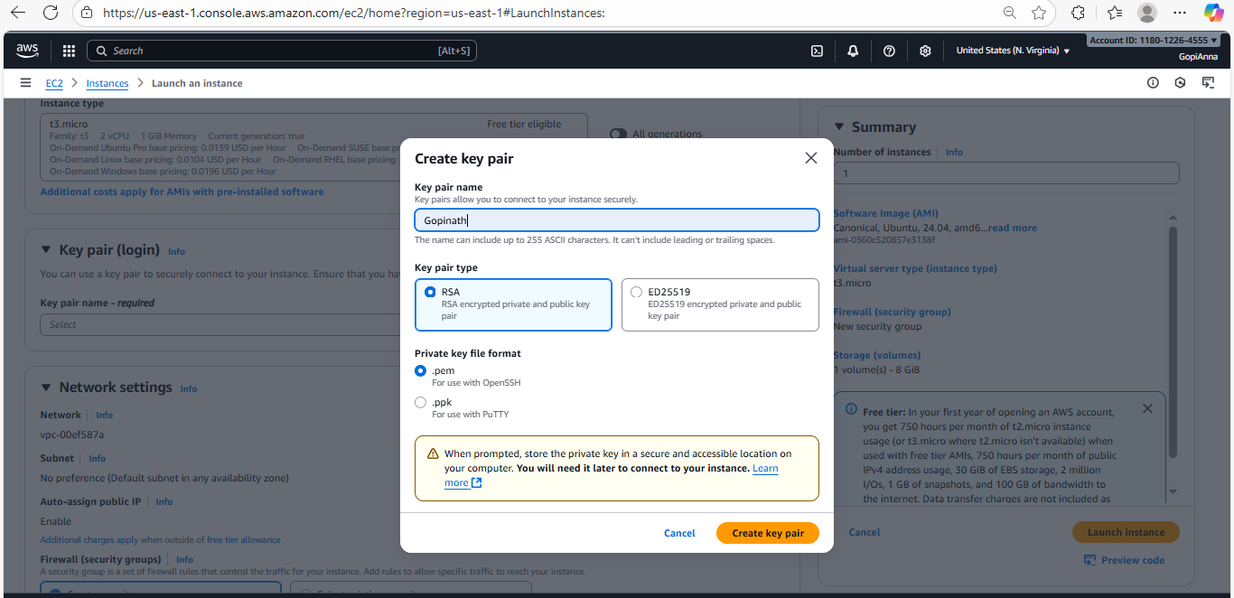
Key pair => create new key pair as follow create pem

Slide 6
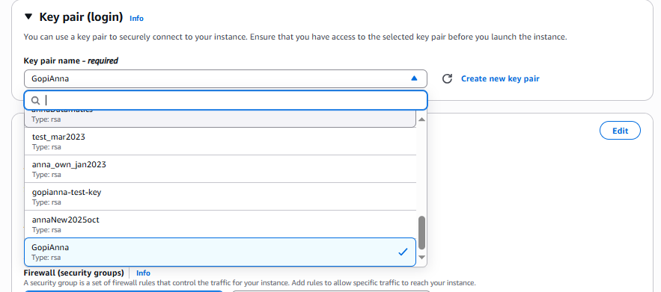
pem automatically download ,file permission should be 400 here we are using existing key pair

Slide 7
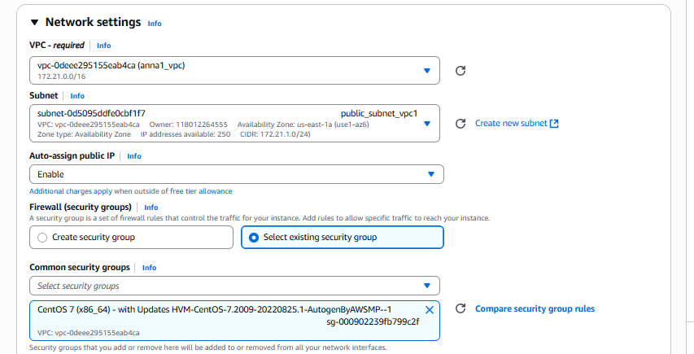
go with existing VPC and subnet SG group

Slide 8
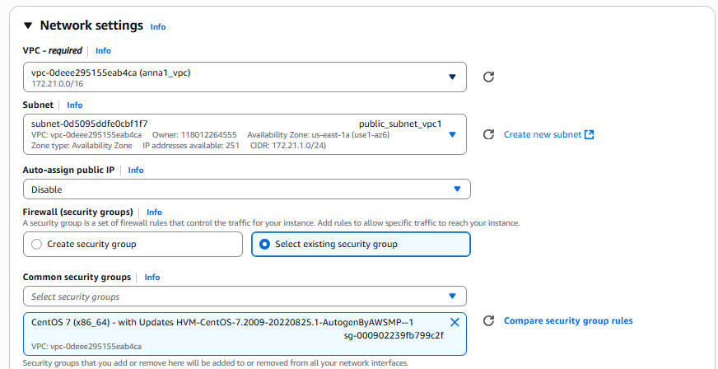
VPC
we can create new VPC or go with existing
click edit choose --> existing VPC -->subnet
If you want connect from internet enable the Auto-assign public IP --> Enable
Firewall(security group)
common security
select existing common security group

Slide 9
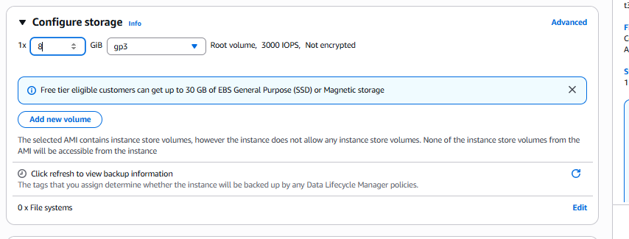
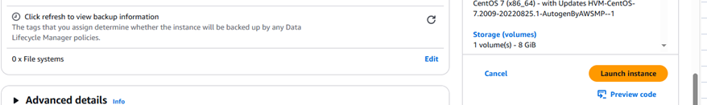
Storage at least 8GB then click Launch Instance, If we need add ESB volume add new volume

Slide 10
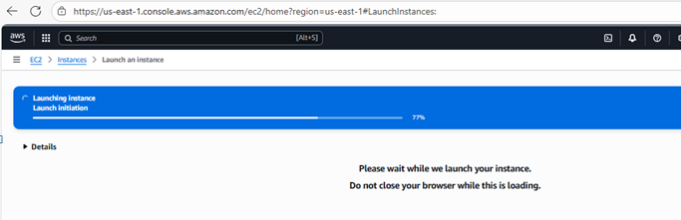
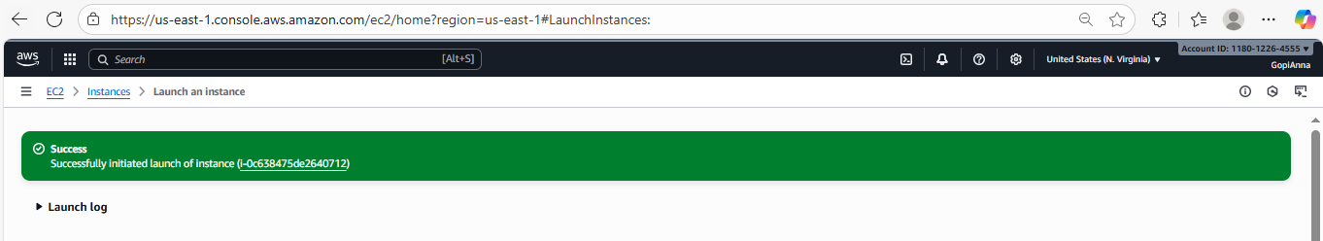
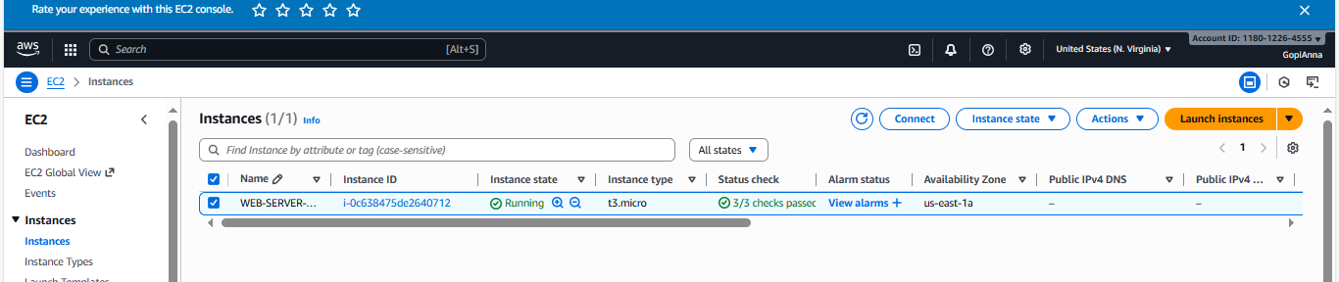

Slide 11
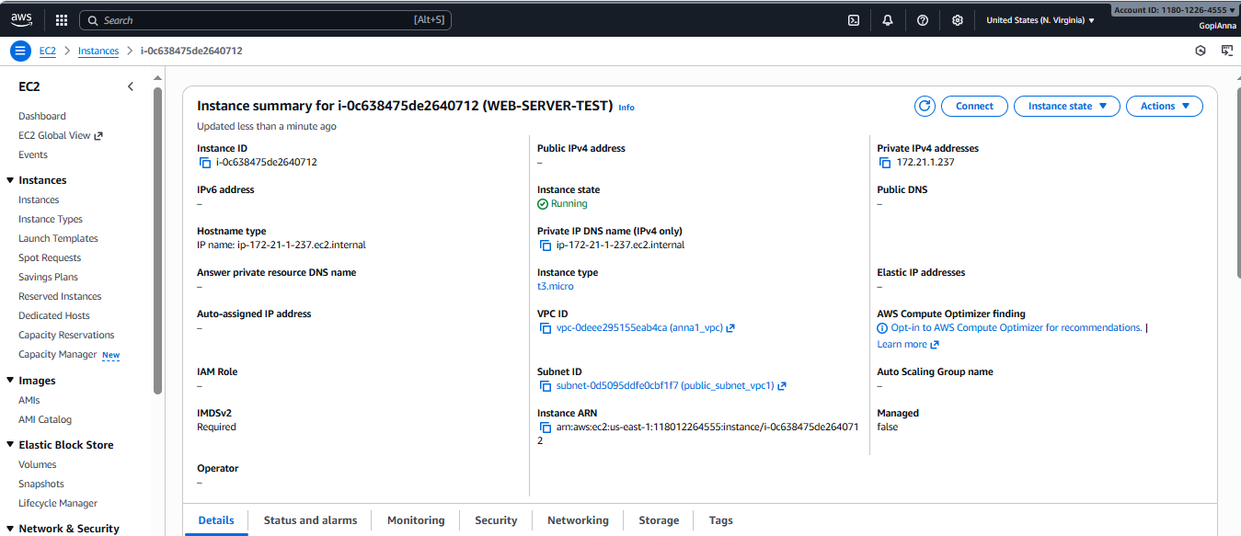

Slide 12
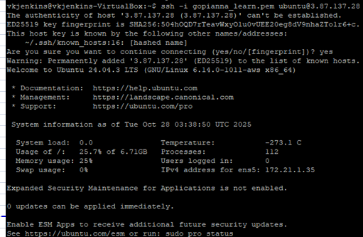
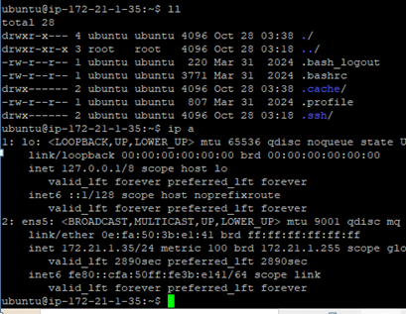
SSH to EC2 Instance

Slide 13
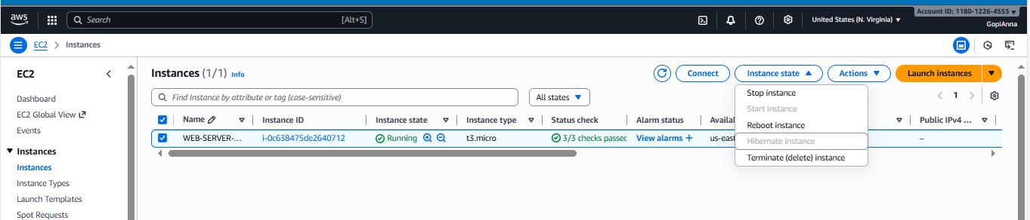
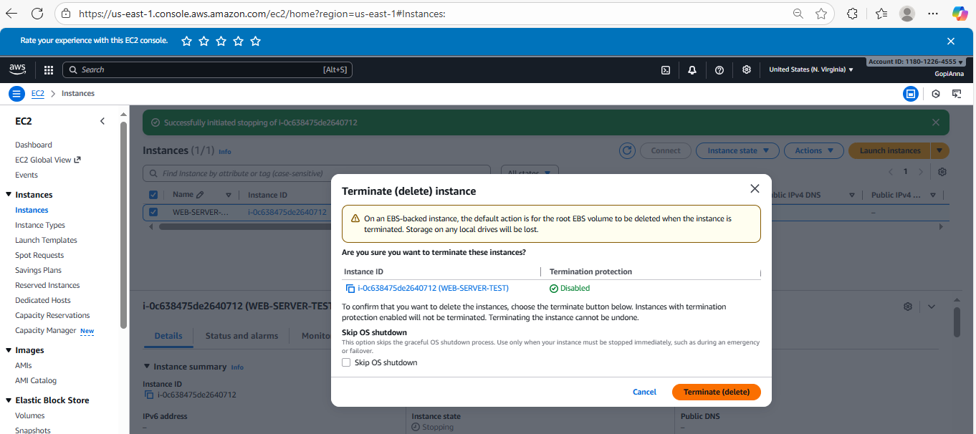
Terminate the Instance as follows

Slide 14


